Slide 1

Ease Work
Vaishnavi Bhojak 23107022
Nishigandha Sawant 23107047
Nidhi Shettigar 23107041
Abhishek Sali 23107004
Project Guide
Ms. Aishwarya Londhe

Slide 2
Contents
Introduction
Objectives
Scope
Features / Functionality
Project Outcomes
Technology Stack
Block Diagram if applicable

Slide 3
1. Introduction
Problem Identified :
Employees and HR struggle with scattered tools for attendance, leave tracking, HR documents, performance, and task management, leading to inefficiency and productivity loss.
Solution Proposed :
A centralized dashboard integrating attendance, leave tracking, HR documents, performance reviews, and task management to streamline workplace operations.
Employees can efficiently manage their work, access essential resources, and stay organized with features like a holiday calendar, digital visiting cards, and to-do lists in one platform.

Slide 4
2. Objectives
To provide platform for managing employee profiles, offering easy logins and personalized profile creation.
To streamline attendance system, leave application and easy to view holiday calendar.
To enhance networking with personalized visiting cards, which can be easily shared through QR codes for efficient exchange of contact details.
To enable performance tracking, allowing users to add documents and create To-Do list with comprehensive tools.

Slide 5
3. Scope
This project can be applied in corporate offices, startups, remote working setups, and large-scale organizations for centralized employee management.
It can be useful to employees for tracking their performance, managing tasks, and applying for leaves
HR teams for document management and attendance tracking, and managers for monitoring team performance and approvals.

Slide 6
4. Feature /Functionality
Feature 1 : User Profile
This feature allows employees to create and manage their profiles, including personal details, job roles, contact information, and profile images.
Feature 2 : Leave Application
Employees can request leaves, track their leave history, and check their remaining balance, while managers can approve or decline requests in an efficient approval system
Feature 3 : Attendance System
This feature tracks employees’ clock-in/out times, and attendance records marking them as present or late mark

Slide 7
4. Feature /Functionality
Feature 4: HR Documents:
This feature provides a secure section for uploading and storing work-related documents and certificates. Employees can easily upload required files and download policies, contracts, and other HR-related documents as needed, ensuring seamless document management.
Feature 5: To-Do
List Enables employees to create, manage, and prioritize tasks with deadlines, helping them stay organized, track progress, and boost productivity.
Feature 6: Performance
Provides a detailed analysis of employee performance through various indicators and visualizations, including pie charts and reports, to help track progress and identify areas for improvement.

Slide 8
4. Feature /Functionality
Feature 7: Holiday Calendar
Displays a complete yearly calendar with all company holidays, including festival holidays and special events, helping employees plan their leaves and manage schedules effectively.
Feature 8: Visiting Card
Generates a personalized digital visiting card based on user-provided details, which can be downloaded and saved on the PC for professional use and easy sharing.

Slide 9
5. Outcome of Project
The final output of the Ease Work project will include:
Secure employee login and profile management with detailed information and profile pictures.
Leave application and tracking with real-time approval status.
Attendance system for clock-in/out, work hours tracking, and reports.
Secure upload and download of HR documents, policies, and certificates.
Task management through a to-do list with deadlines and priorities.
Performance analysis with detailed metrics and visual reports.
Holiday calendar showcasing company and festival holidays.
Personalized digital visiting card generation for employees.

Slide 10
6. Technology Stack
Frontend: Python 3.11, PycharmIDE
Backend: MySQL
Open Libraries: Tkinter, CustomTkinter, Matplotlib, Pillow, Datetime.

Slide 11
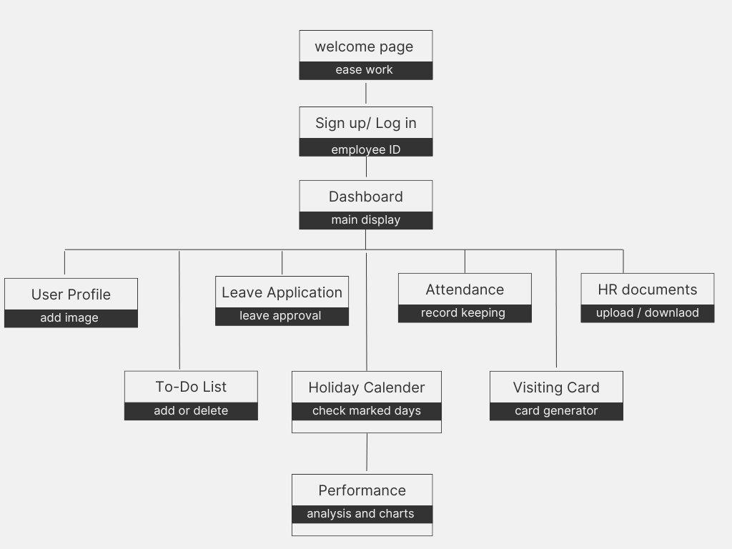
7. Block Diagram

Slide 12
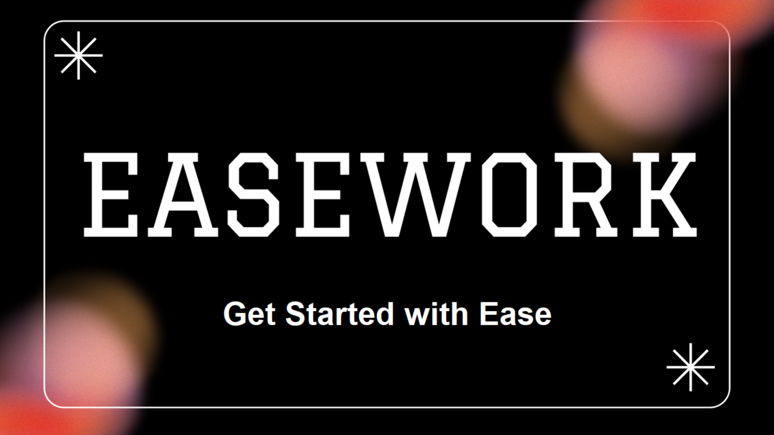
7. Project Outcome

Slide 13
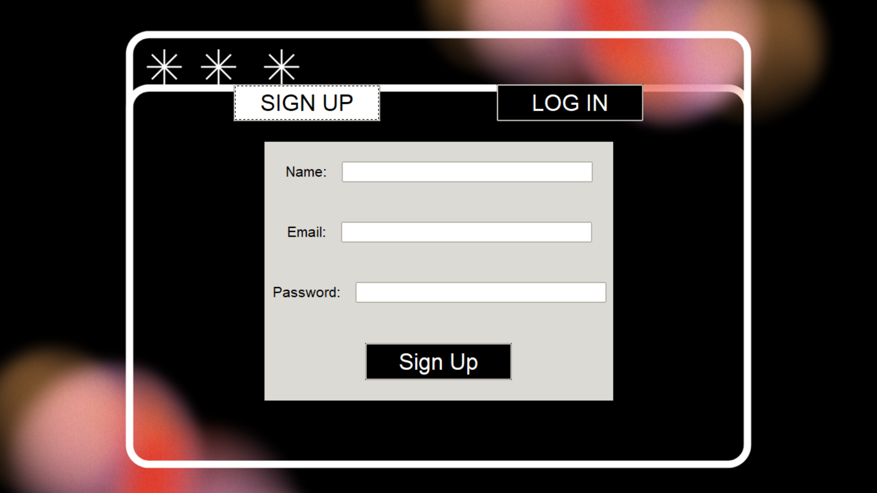

Slide 14
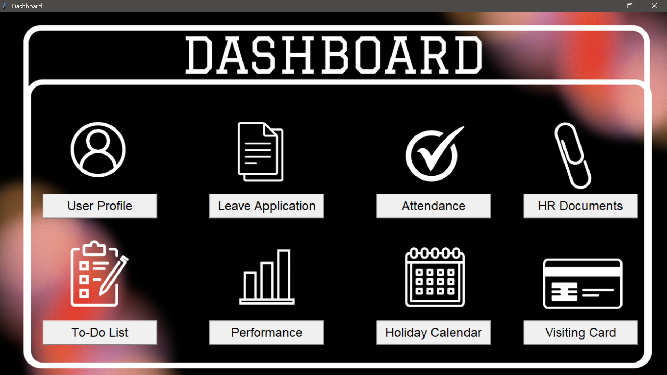

Slide 15
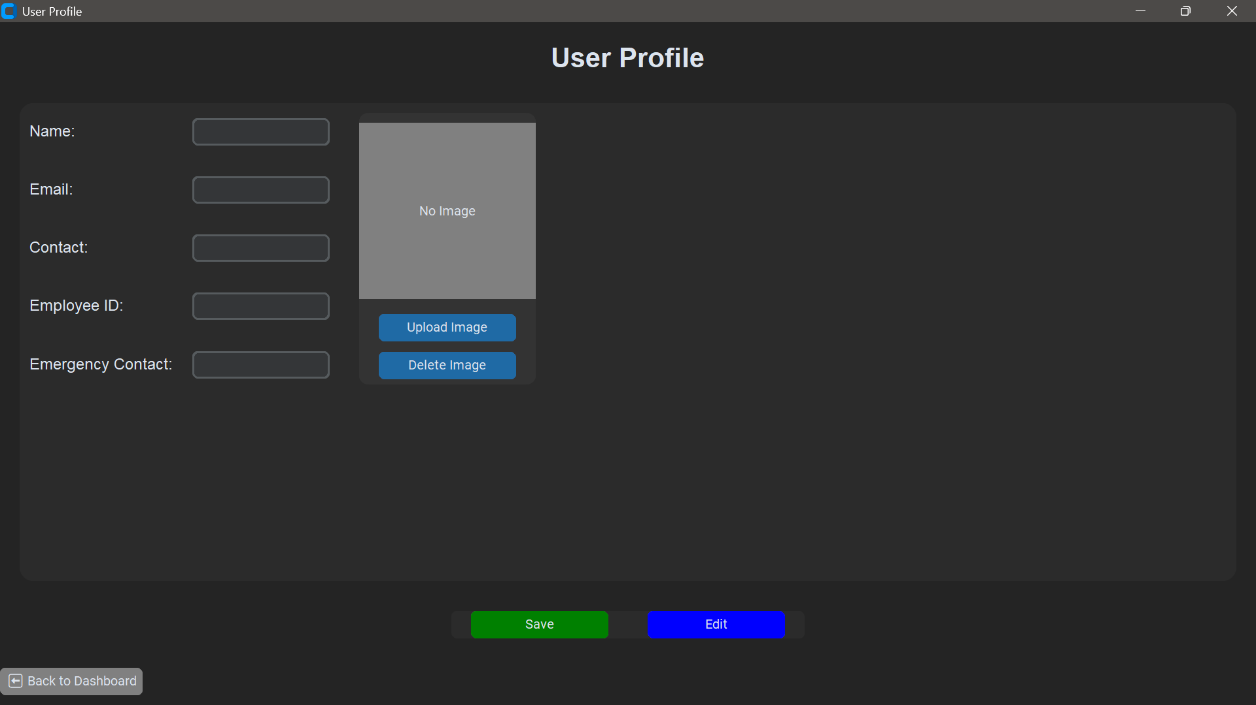

Slide 16
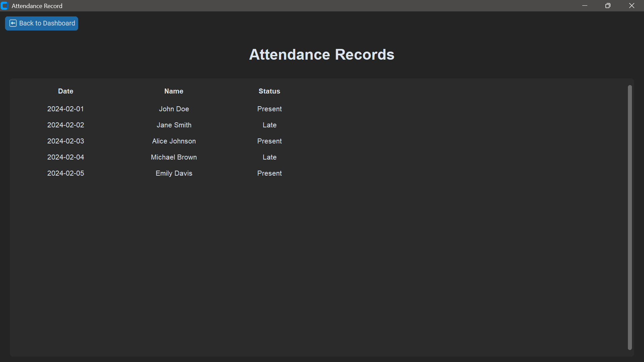

Slide 17
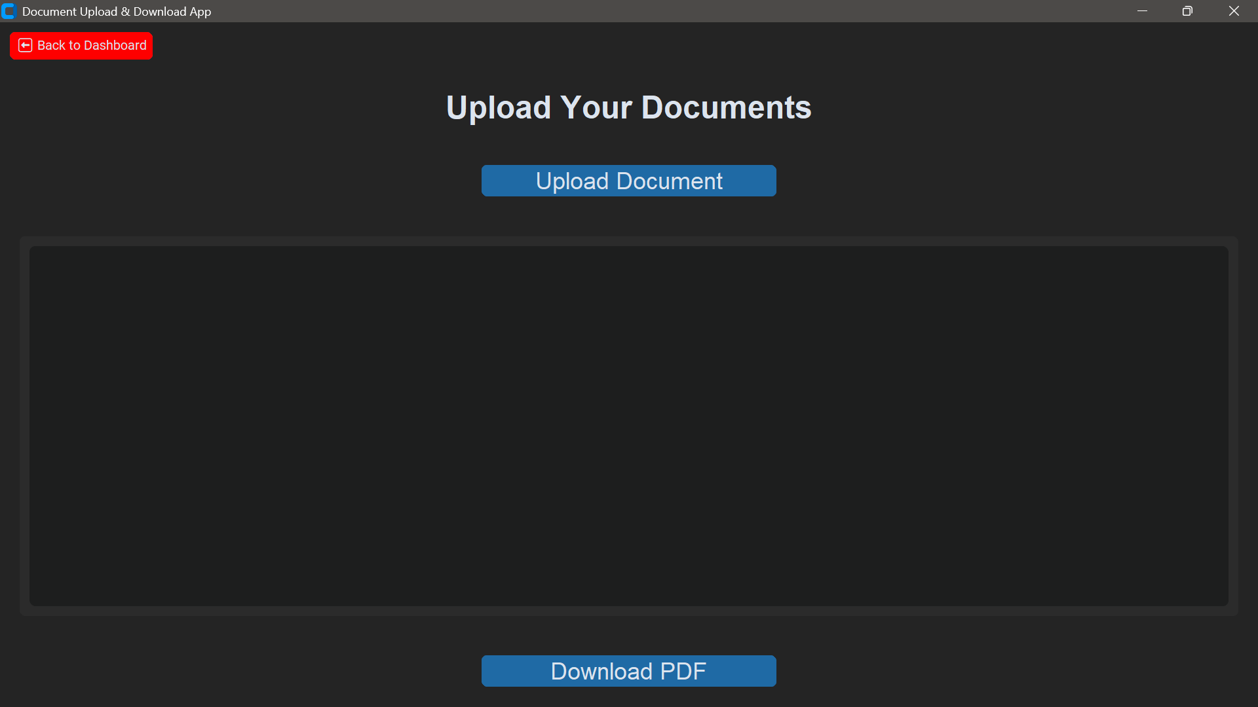

Slide 18
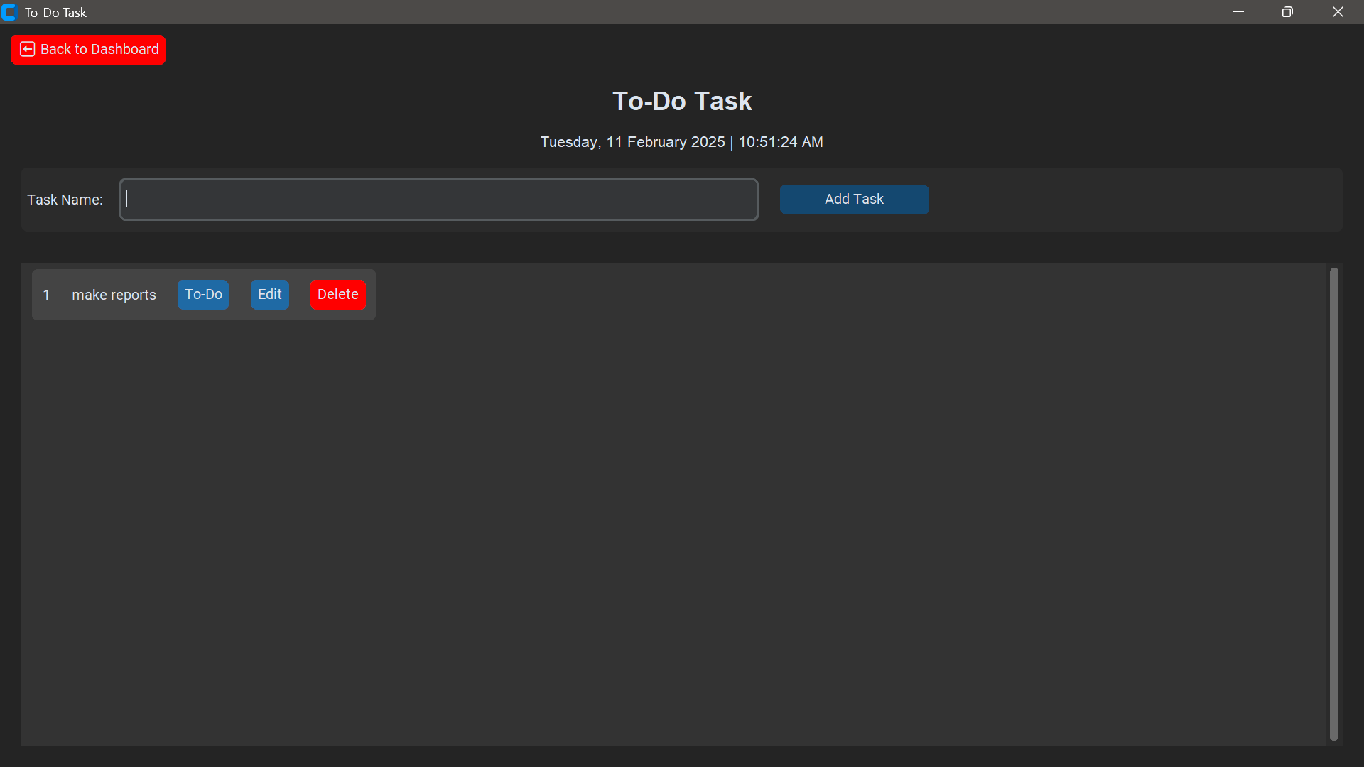

Slide 19
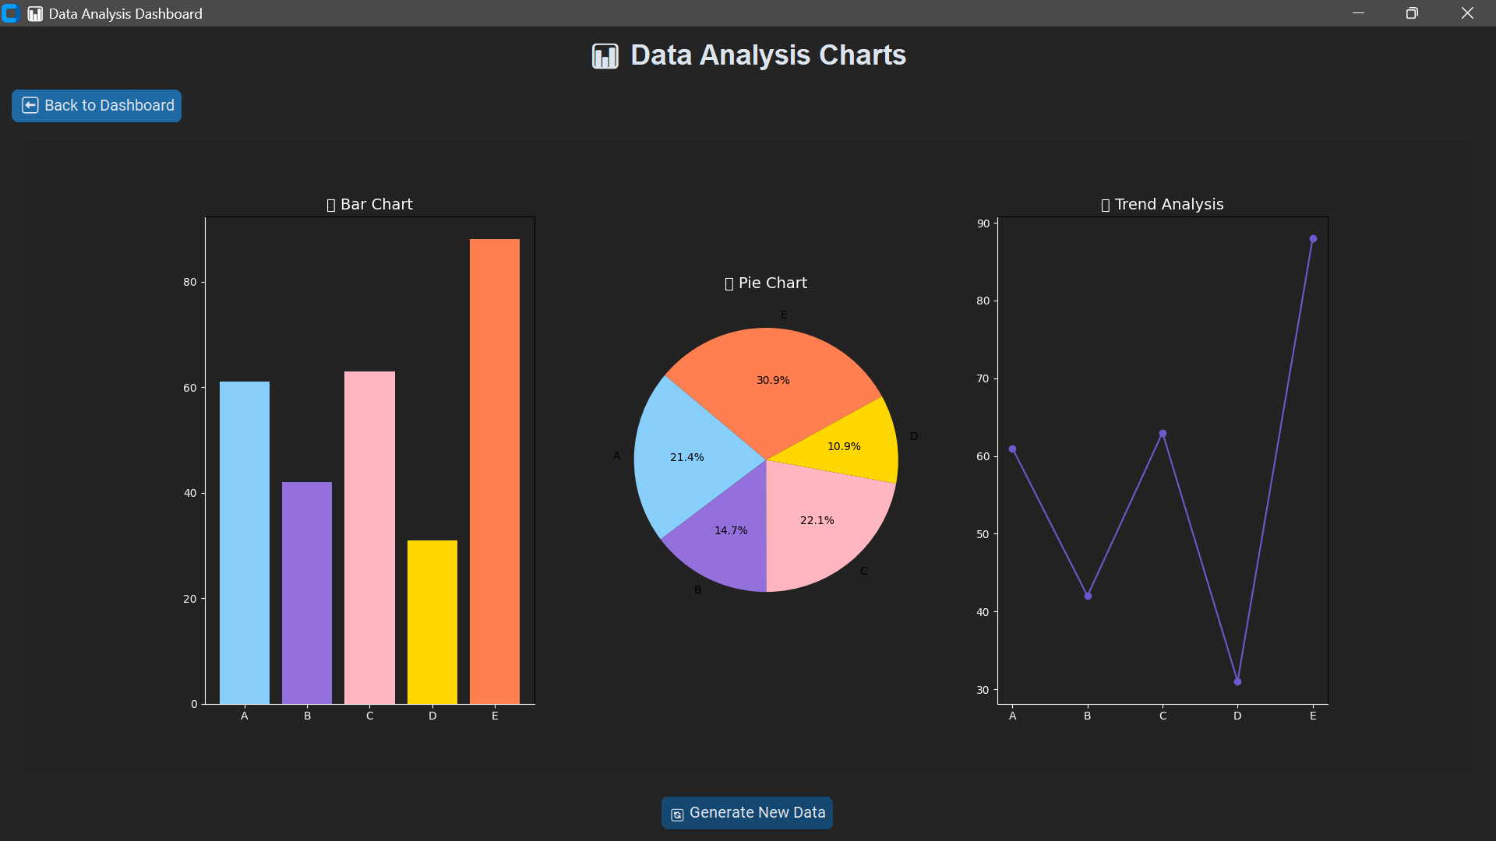

Slide 20
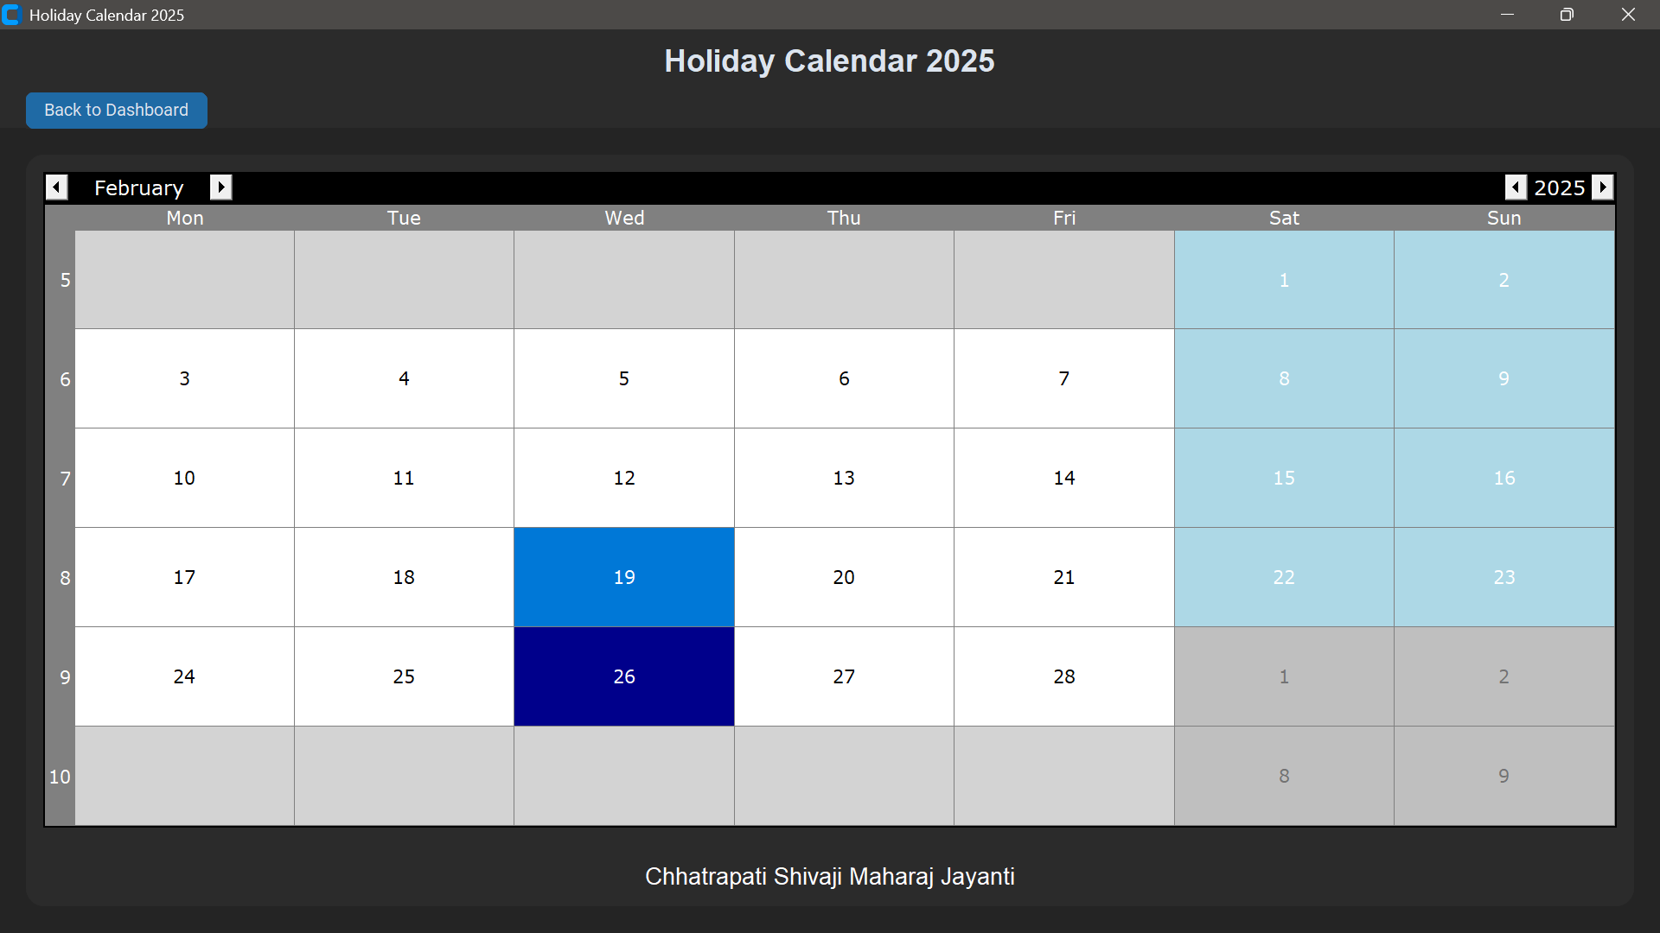

Slide 21
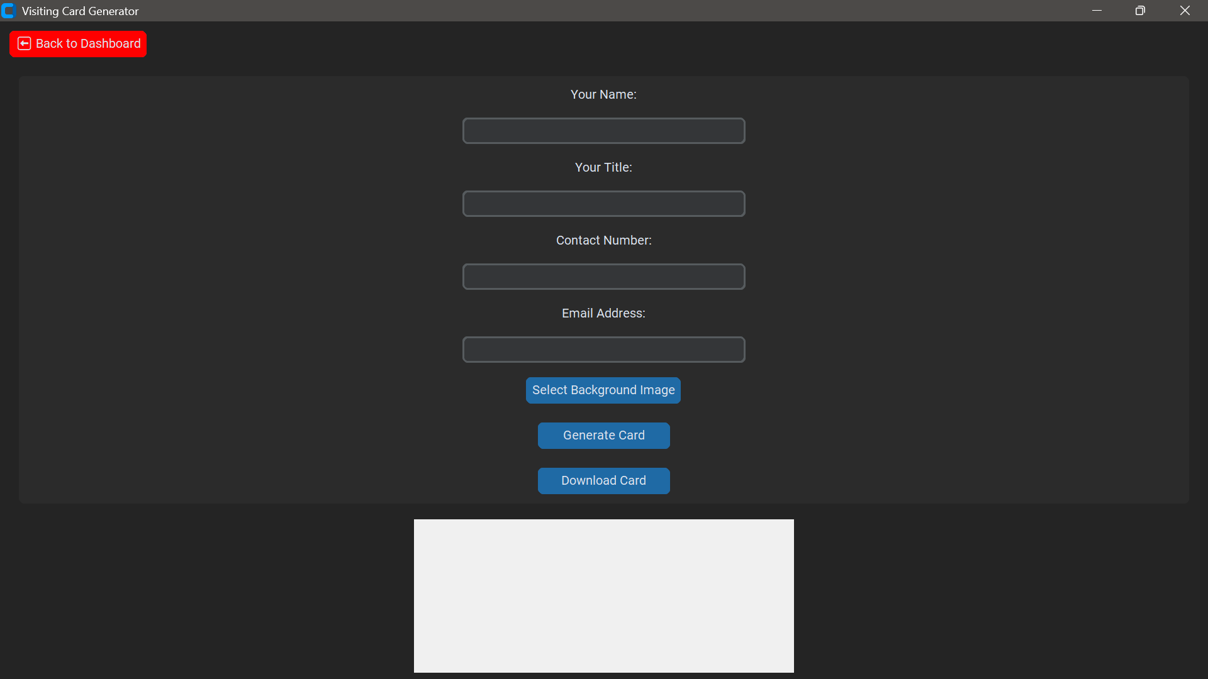

Slide 22
Thank You...!!

